Slide 1
Computational Foundations for ML (10-607):
Overview & Propositional Logic
Bryan Wilder
* Slides borrowed from prior offerings of the course by Professors M. Gormley, P. Virtue, & G. Gordon.

Slide 2
Course Overview
Goals:
A formal presentation of computational background needed to understand ML
Motivated by (carefully chosen) real-world problems that arise in ML applications,
Audience:
students wishing to prepare for future coursework in Machine Learning

Slide 3
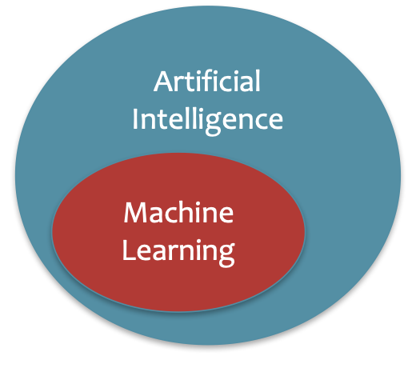
What is Artificial Intelligence?
The basic goal of AI is to develop intelligent machines.
Intelligence is the computational part of the ability to achieve goals in the world.
This consists of many sub-goals:
Perception
Reasoning
Control/Motion/Manipulation
Planning
Communication
Creativity
Learning
…
Notes:
http://www-formal.stanford.edu/jmc/whatisai/whatisai.html

Slide 4
What is Machine Learning?
Machine learning aims to design algorithms that automatically extract valuable information from data by modeling the data-generating process.
Data
Model
Learning

Slide 5
What is Machine Learning?
Machine learning aims to design algorithms that automatically extract valuable information from data by modeling the data-generating process.
Data → Vectors, Matrices, Data Structures
Model → Probability
Learning → Optimization, Algorithm Design and Analysis

Slide 6
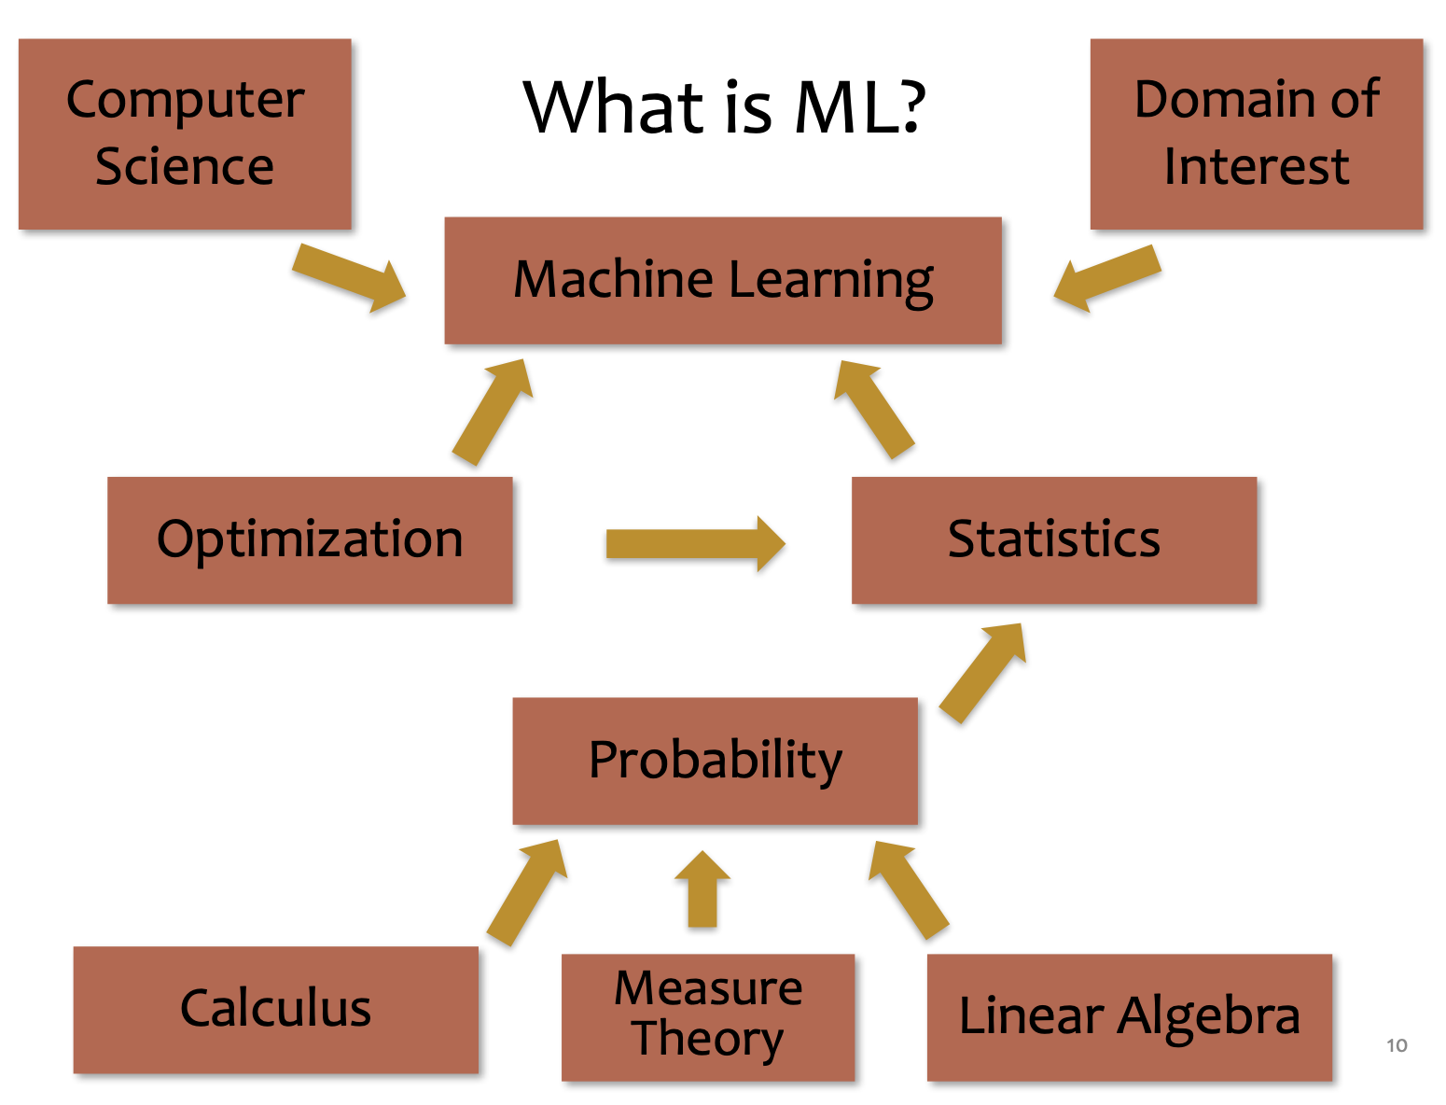
What is Machine Learning?

Slide 7
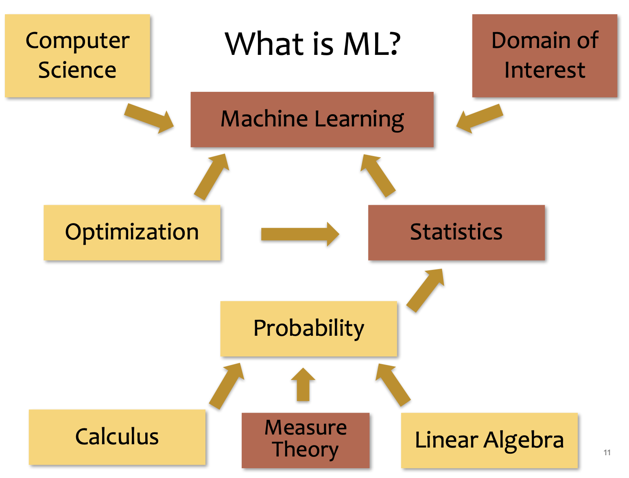
What is Machine Learning?

Slide 8
This course
Writing formal proofs
Propositional logic
Proof strategies
Computational complexity
Data structures
Algorithms

Slide 9
Course website
https://github.com/bwilder0/10607-f24 (Link also in canvas)
This is where we will maintain the class schedule, post lecture notes, etc. Also has the syllabus and policies.
Assignments: Canvas, submitted via Gradescope
OH Schedule: Canvas

Slide 10
Grading and policies
50%: Homeworks due each week (gradescope)
First one due Sunday!
50%: 3 in-person quizzes
All information is on the course website

Slide 11
Course structure
Monday/Wednesday: lecture with instructor
Friday: recitation with TA
Sunday EOD: homework due

Slide 12
Expected Background
We’re assuming mathematical maturity: you should be familiar with the idea of derivations and proofs, and of building formal representations for objects given their English­ description.
We’ll assume that you can take scalar derivatives.
We’ll assume that you’ve seen real vector spaces and matrices (linear operators) and know how to reason about things like matrix multiplication and solving systems of linear equations.
We’ll assume that you’ve seen sets and data types.
We’ll assume that you’ve worked with probabilities (e.g., conditioning, Bayes rule).
We will also assume familiarity with coding. The assignments and in-class activities will include some Python.

Slide 13
Why Computer Science for ML?
10-607
To best understand A we need B
A | B
Analysis of Inference in Graphical Models | Computation Computational Complexity Recursion; Dynamic Programming
Implementation Design of a Deep Learning Library | Programming & Efficiency Debugging for Machine Learning Data structures and algorithms for automatic differentiation
Optimization algorithms for training neural networks | Optimization Unconstrained Optimization Preconditioning, momentum, adaptation
Slide credit: CMU MLD Matt Gormley

Slide 14
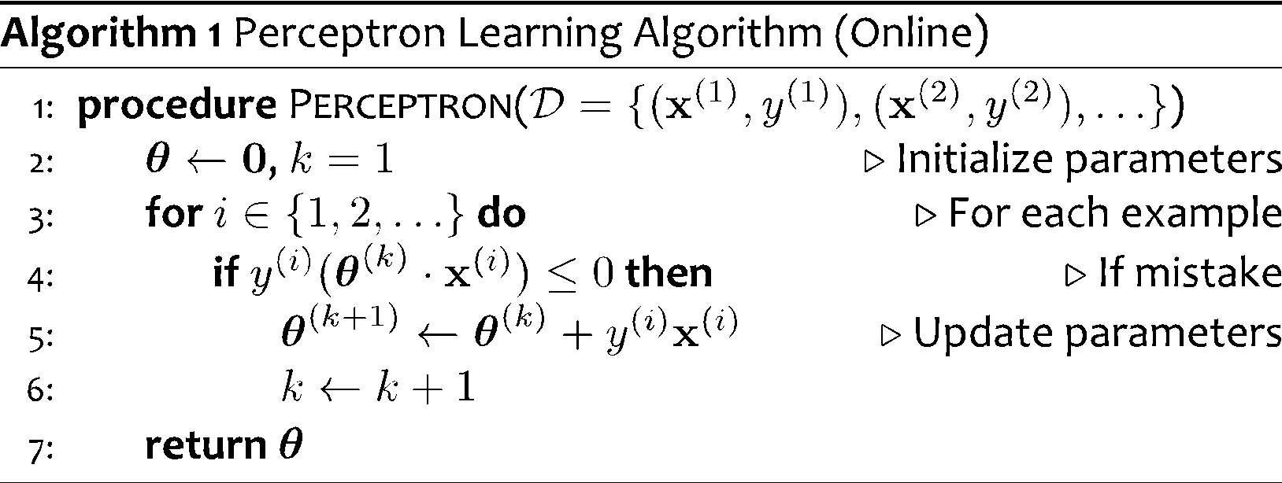
Perceptron for Binary Classification
Note: This is just motivation – we’ll cover the background need to understand these topics later!

Slide 15
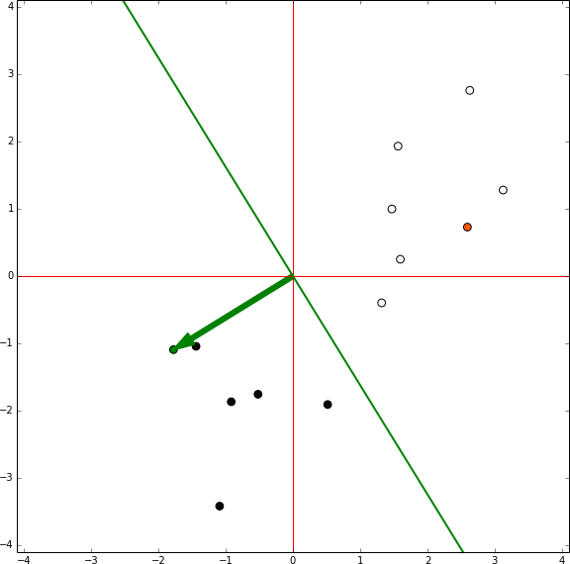
Perceptron for Binary Classification

Slide 16
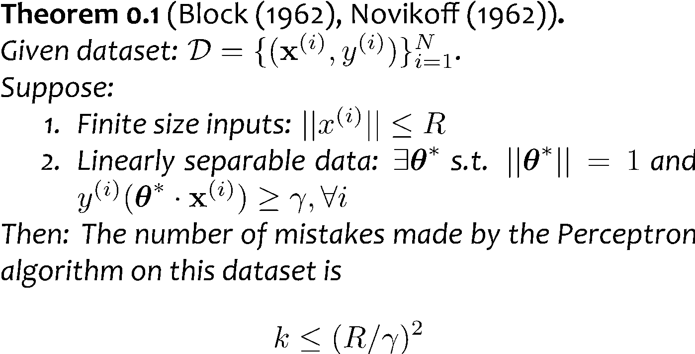

Analysis: Perceptron
Perceptron Mistake Bound
+
+
+
+
γ
+
-
γ
+
+
-
+
-
-
Note: This is just motivation – we’ll cover the background need to understand these topics later!
-
R
-
-
-
-
Figure from Nina Balcan

Slide 17
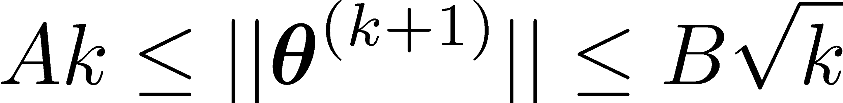
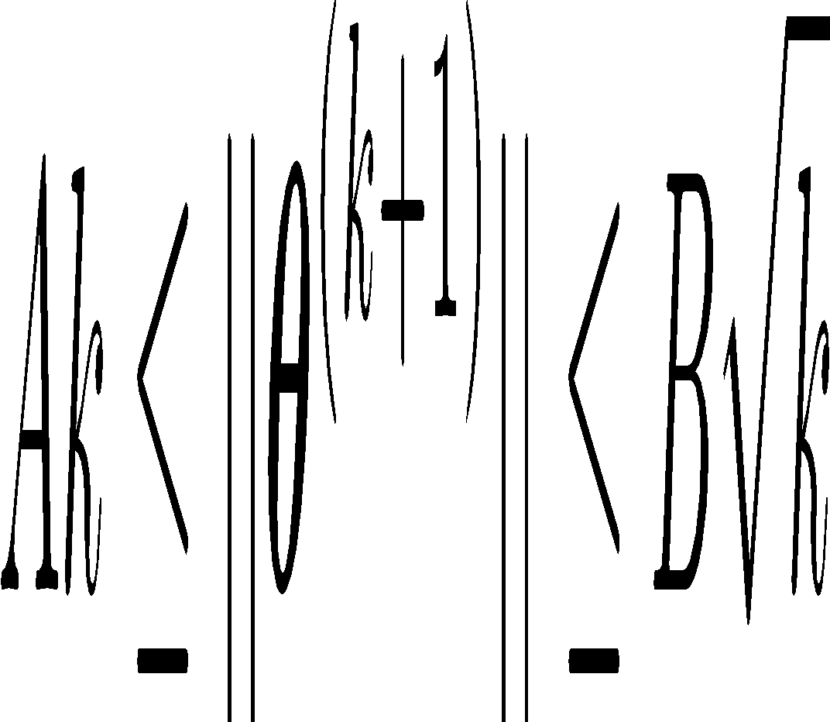
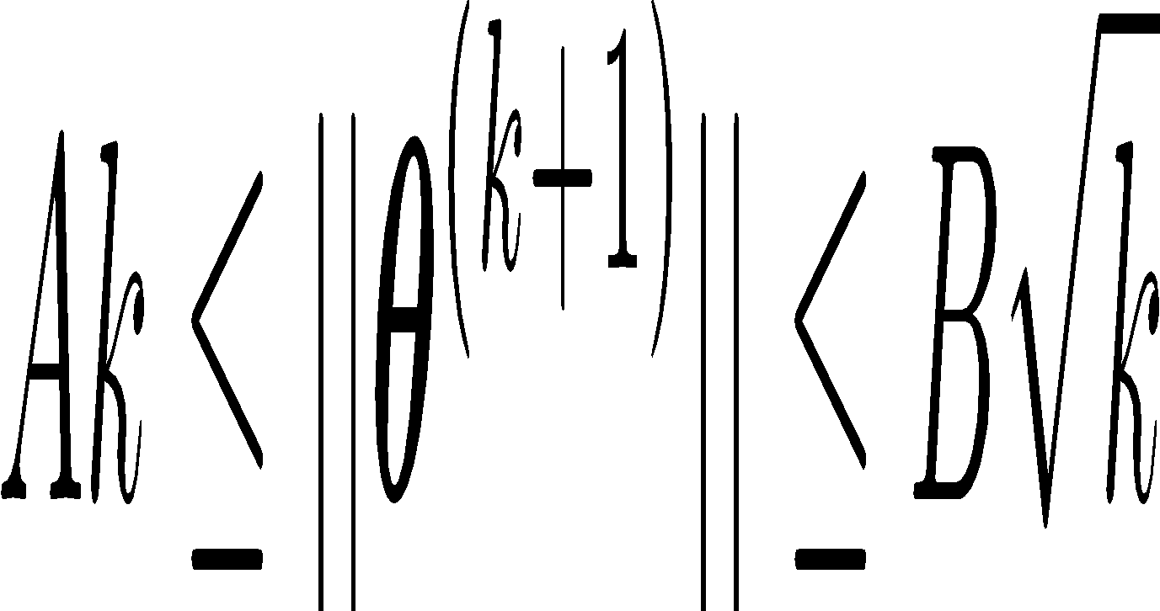
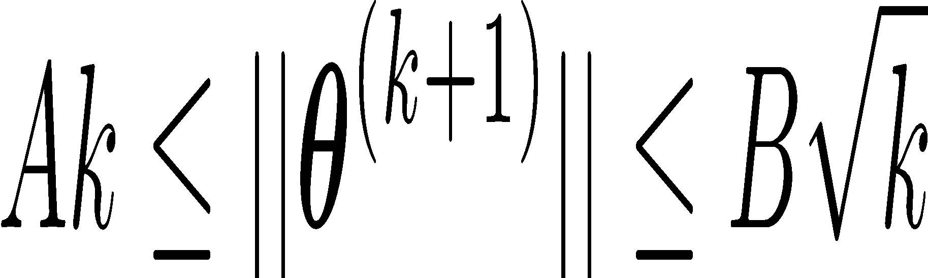
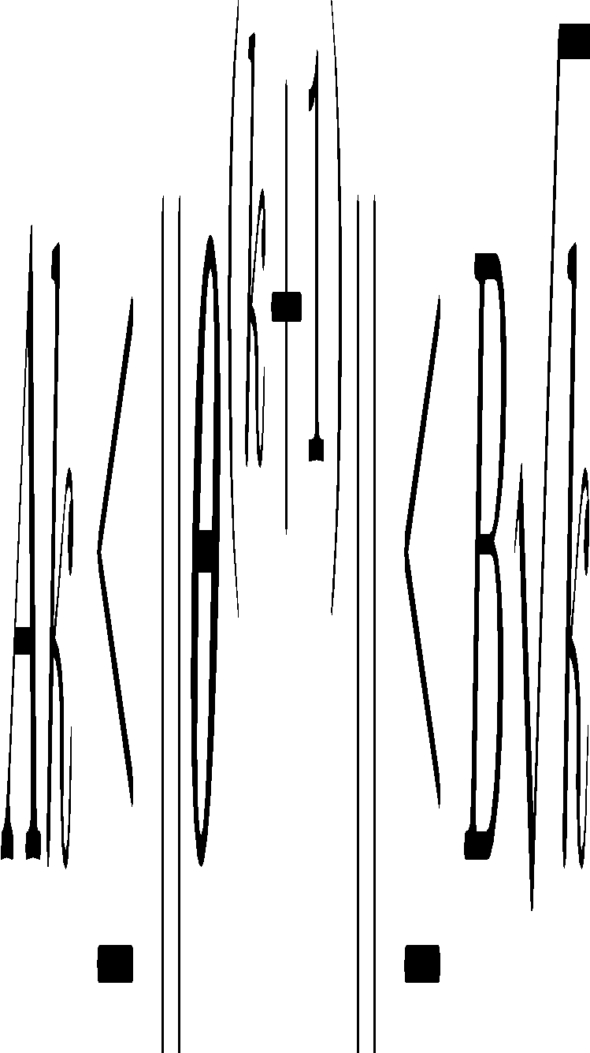
Analysis: Perceptron
Proof of Perceptron Mistake Bound:
We will show that there exist constants A and B s.t.
Note: This is just motivation – we’ll cover the background need to understand these topics later!

Slide 18
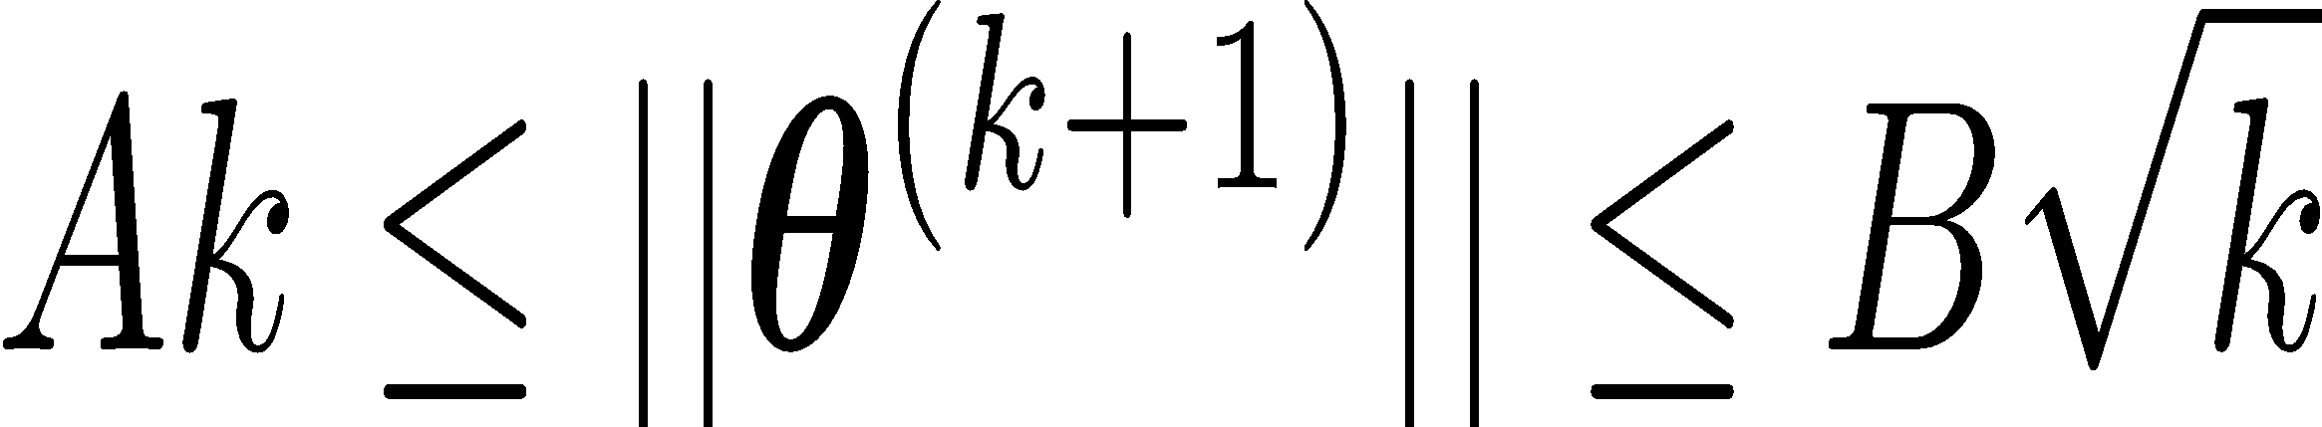
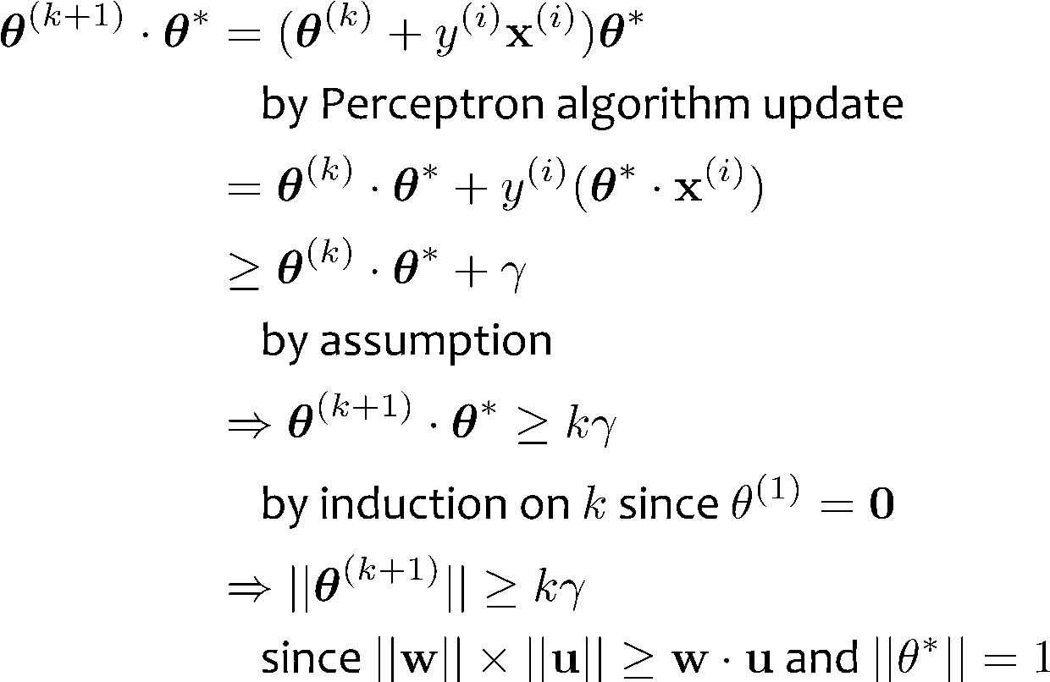
Analysis: Perceptron
Proof of Perceptron Mistake Bound: Part 1: for some A,
Note: This is just motivation – we’ll cover the background need to understand these topics later!
Cauchy-Schwartz inequality
Notes:
Intuition \theta is gradually approaching \theta*
Part 1: The dot product of \theta and \theta* increases rapidly O(k)
Part 2: The norm of \theta increases slowly \Omega(\sqrt(k))

Slide 19
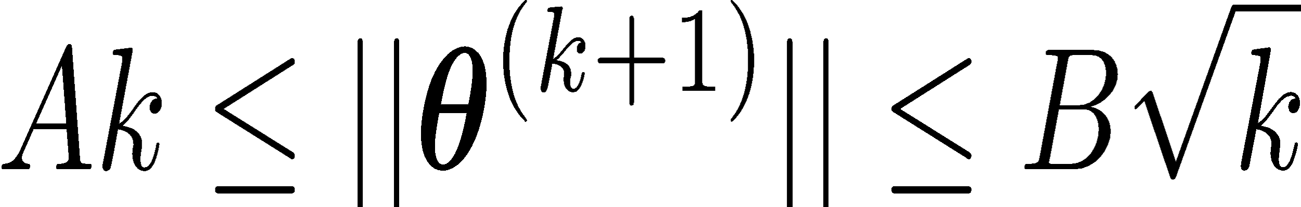
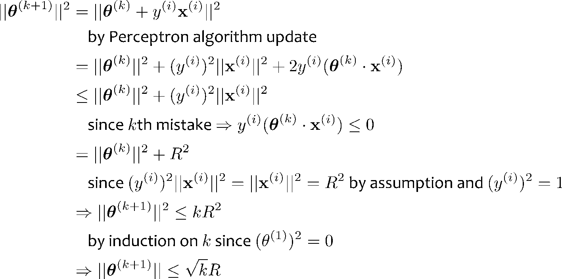
Analysis: Perceptron
Proof of Perceptron Mistake Bound: Part 2: for some B,
Note: This is just motivation – we’ll cover the background need to understand these topics later!
Notes:
Intuition \theta is gradually approaching \theta*
Part 1: The dot product of \theta and \theta* increases rapidly O(k)
Part 2: The norm of \theta increases slowly \Omega(\sqrt(k))

Slide 20
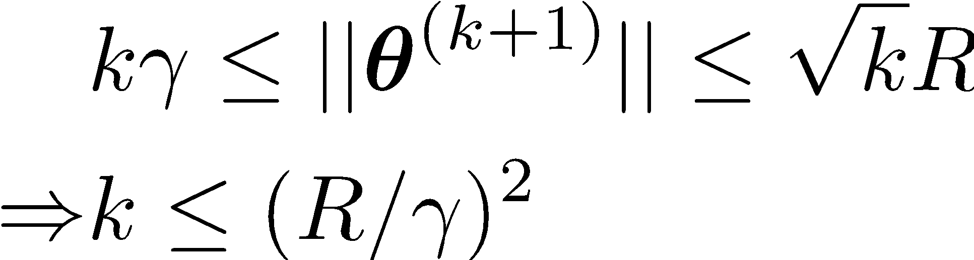
Analysis: Perceptron
Proof of Perceptron Mistake Bound: Part 3: Combining the bounds finishes the proof.
The total number of mistakes must be less than this
Note: This is just motivation – we’ll cover the background need to understand these topics later!

Slide 21
Why Computer Science for ML?
10-607
To best understand A we need B
A | B
Analysis of Exact Inference in Graphical Models | Computation Computational Complexity Recursion; Dynamic Programming Data Structures for ML Algorithms
Implementation Design of a Deep Learning Library | Programming & Efficiency Debugging for Machine Learning Efficient Implementation / Profiling ML Algorithms
Optimization for Support Vector Machines (SVMs) | Optimization Unconstrained Optimization Preconditioning Constrained Optimization
Slide credit: CMU MLD Matt Gormley

Slide 22
Why Computer Science for ML?
10-607
To best understand A we need B
A | B
Analysis of Exact Inference in Graphical Models | Computation Computational Complexity Recursion; Dynamic Programming Data Structures for ML Algorithms
Implementation Design of a Deep Learning Library | Programming & Efficiency Debugging for Machine Learning Efficient Implementation / Profiling ML Algorithms
Optimization for Support Vector Machines (SVMs) | Optimization Unconstrained Optimization Preconditioning Constrained Optimization
Slide credit: CMU MLD Matt Gormley

Slide 23
Backpropagation
Training
Automatic Differentiation – Reverse Mode (aka. Backpropagation)
Forward Computation
Write an algorithm for evaluating the function y = f(x). The algorithm defines a directed acyclic graph, where each variable is a node (i.e. the “computation graph”)
Visit each node in topological order. For variable u_{i} with inputs v₁,…, v_{N}
Compute u_{i} = g_{i}(v₁,…, v_{N})
Store the result at the node
Backward Computation
Initialize all partial derivatives dy/du_{j} to 0 and dy/dy = 1.
Visit each node in reverse topological order. For variable u_{i} = g_{i}(v₁,…, v_{N})
We already know dy/du_{i}
Increment dy/dv_{j} by (dy/du_{i})(du_{i}/dv_{j}) (Choice of algorithm ensures computing (du_{i}/dv_{j}) is easy)
Slide credit: CMU MLD Matt Gormley
Note: This is just motivation – we’ll cover the math need to understand these topics later!
Return partial derivatives dy/du_{i} for all variables

Slide 24
Propositional Logic and Proofs

Slide 25
Arguments
Assumptions/premises
Steps to make conclusions that follow from premises.
Informal
Formal

Slide 26
Example
Argue that Socrates is mortal!

Slide 27
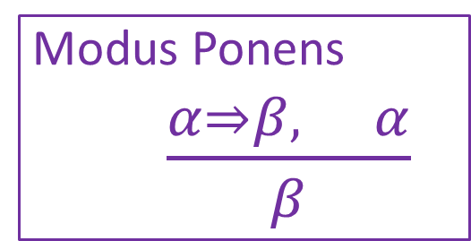
Example
Let’s be more formal:
Give an explicit justification for each statement
based on previous statements.
Prove that Socrates is mortal!
Notation Alert!

Slide 28
Which of the following are valid arguments?
If a meal is a sandwich, it has bread
This meal is a sandwich
Therefore, it has bread
If a bird is a swan, it has white feathers
This bird has white features
Therefore, it is a swan
If the dog is hungry, it will bark
The dog has not barked
Therefore, it is not hungry

Slide 29
Propositional Logic
Symbol:
Variable that can be true or false
Denoted using letters (a, b, p, q, etc)
Often include True and False (T and F)
Operators/connectives:
¬ A: not A
A ∧ B: A and B (conjunction)
A ∨ B: A or B (disjunction) Note: this is not an “exclusive or”
A ⇒ B: A implies B (implication). If A then B
A ⇔ B: A if and only if B (biconditional)
to construct expressions/sentences

Slide 30
Propositional Logic
Translate to propositional logic:
“You cannot ride the roller coaster if you are under 4 feet tall unless you are older than 16 years old.”

Slide 31
Propositional Logic
Determine whether these system specifications are consistent:
“The diagnostic message is stored in the buffer or it is retransmitted.”
“The diagnostic message is not stored in the buffer.”
“If the diagnostic message is stored in the buffer, then it is retransmitted.”

Slide 32
Propositional Logic
Determine whether these system specifications are consistent:
“The diagnostic message is stored in the buffer or it is retransmitted.”
“The diagnostic message is not stored in the buffer.”
“If the diagnostic message is stored in the buffer, then it is retransmitted.”
Do the system specifications remain consistent if the specification “The diagnostic message is not retransmitted” is added?

Slide 33
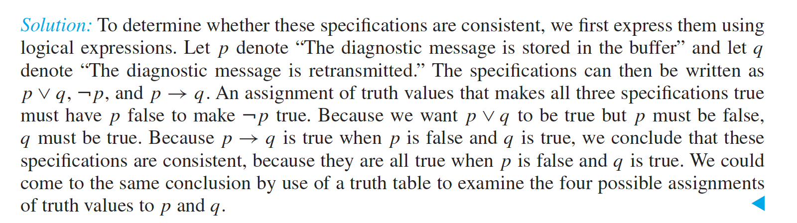
Propositional Logic
Determine whether these system specifications are consistent:
“The diagnostic message is stored in the buffer or it is retransmitted.”
“The diagnostic message is not stored in the buffer.”
“If the diagnostic message is stored in the buffer, then it is retransmitted.”

Slide 34
Propositional Logic Semantics
Truth Tables for ∧ and ∨
𝛂 | 𝛃 | 𝛂 ∧ 𝛃
F | F | F
F | T | F
T | F | F
T | T | T
𝛂 | 𝛃 | 𝛂 ∨ 𝛃
F | F | F
F | T | T
T | F | T
T | T | T

Slide 35
Notes on Operators
𝛂 ∨ 𝛃 is inclusive or, not exclusive

Slide 36
Notes on Operators
𝛂 ∨ 𝛃 is inclusive or, not exclusive
𝛂 ⇒ 𝛃 is equivalent to ¬𝛂 ∨ 𝛃
Says who?

Slide 37
Truth Tables
𝛂 ⇒ 𝛃 is equivalent to ¬𝛂 ∨ 𝛃
𝛂 | 𝛃 | 𝛂 ⇒ 𝛃 | ¬𝛂 | ¬𝛂 ∨ 𝛃
F | F | T | T | T
F | T | T | T | T
T | F | F | F | F
T | T | T | F | T

Slide 38
One interesting consequence:
If a is always false, then a ⇒ b is true for any b!
(i.e., ¬a ∨ b is always true)
“If pigs can fly, then 1 + 2 = 5” is true!

Slide 39
Notes on Operators
𝛂 ∨ 𝛃 is inclusive or, not exclusive
𝛂 ⇒ 𝛃 is equivalent to ¬𝛂 ∨ 𝛃
Says who?
𝛂 ⇔ 𝛃 is equivalent to (𝛂 ⇒ 𝛃) ∧ (𝛃 ⇒ 𝛂)
Prove it!

Slide 40
Truth Tables
𝛂 ⇔ 𝛃 is equivalent to (𝛂 ⇒ 𝛃) ∧ (𝛃 ⇒ 𝛂)
𝛂 | 𝛃 | 𝛂 ⇔ 𝛃 | 𝛂 ⇒ 𝛃 | 𝛃 ⇒ 𝛂 | (𝛂⇒𝛃) ∧ (𝛃⇒𝛂)
F | F | T | T | T | T
F | T | F | T | F | F
T | F | F | F | T | F
T | T | T | T | T | T
Equivalence: it’s true in all models. Expressed as a logical sentence:
(𝛂 ⇔ 𝛃) ⇔ [(𝛂 ⇒ 𝛃) ∧ (𝛃 ⇒ 𝛂)]

Slide 41
Truth tables
Exercise: use a truth table to prove that (p ⇔ q) ⇔ (p ∧ q) ∨ (¬p ∧ ¬q)

Slide 42
Exercise 1
If we know that 𝐴 ∨ 𝐵 and ¬𝐵 ∨ 𝐶 are true, what do we know about 𝐴 ∨ 𝐶?
𝐴 ∨ 𝐶 is guaranteed to be true
𝐴 ∨ 𝐶 is guaranteed to be false
We don’t have enough information to say anything definitive about 𝐴 ∨ 𝐶

Slide 43
Exercise 2
If we know that 𝐴 ∨ 𝐵 and ¬𝐵 ∨ 𝐶 are true, what do we know about 𝐴?
𝐴 is guaranteed to be true
𝐴 is guaranteed to be false
We don’t have enough information to say anything definitive about 𝐴

Slide 44
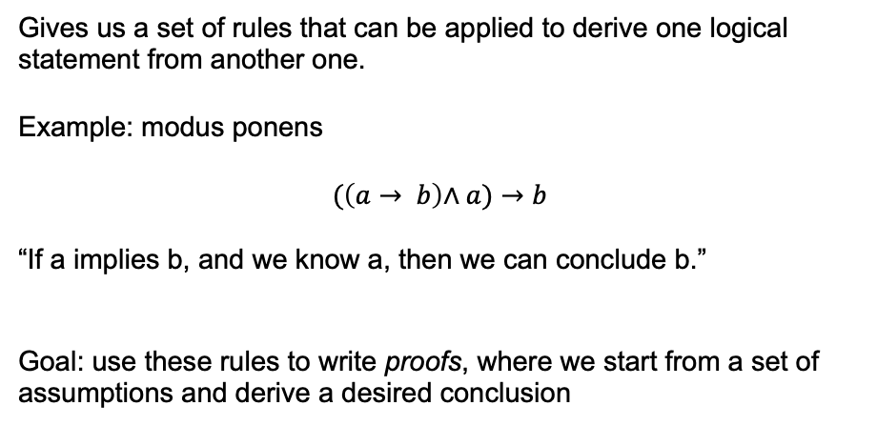
Inference rules
Gives us a set of rules that can be applied to derive one logical statement from another one.
Example: modus ponens
$$(\left(a→ b\right)\text{∧} a)→b$$
“If a implies b, and we know a, then we can conclude b.”
Goal: use these rules to write proofs, where we start from a set of assumptions and derive a desired conclusion

Slide 45
Inference rules
Double negation: ¬¬a is equivalent to a
De Morgan’s laws:
¬(a ∨ b) is equivalent to (¬a ∧ ¬b)
¬(a ∧ b) is equivalent to (¬a ∨ ¬b)
Law of excluded middle: ¬a ∨ a is equivalent to T
Contradiction: ¬a ∧ a is equivalent to F

Slide 46

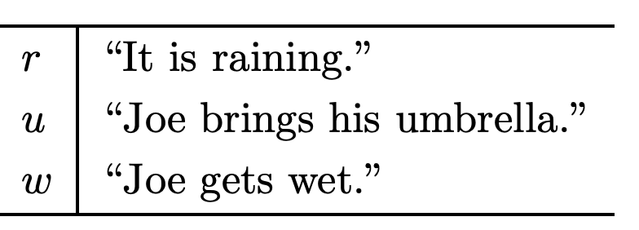
Prove: ¬w
http://infolab.stanford.edu/~ullman/focs/ch12.pdf
Notes:
Introduce r or not r with excluded middle. Then, proof by cases. R: go r -> u, then u to not w. not R: conclude (r or not r) -> not w, so T -> not w and conclude not w by MP

Slide 47
Predicates
Often, we want to make logical statements about any member of a set
Let P(x) denote a statement about a single x
E.g. P(x) = “x is even”
P(1): False
P(2): True

Slide 48
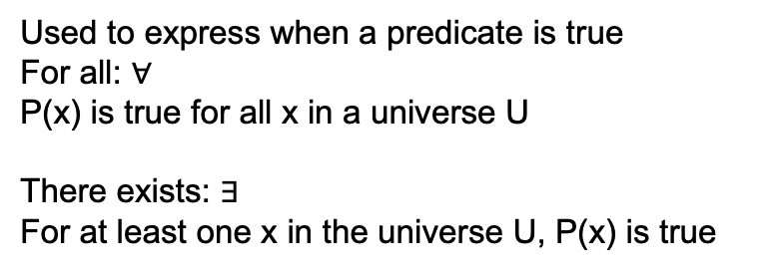
Quantifiers
Used to express when a predicate is true
For all: $∀$
P(x) is true for all x in a universe U
There exists: $∃$
For at least one x in the universe U, P(x) is true

Slide 49
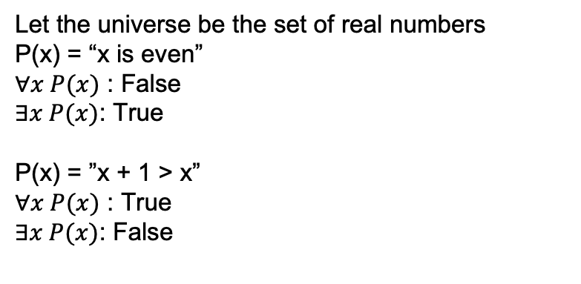
Quantifiers
Let the universe be the set of real numbers
P(x) = “x is even”
$∀x P(x)$ : False
$∃x P(x)$: True
P(x) = ”x + 1 > x”
$∀x P(x)$ : True
$∃x P(x)$: False

Slide 50
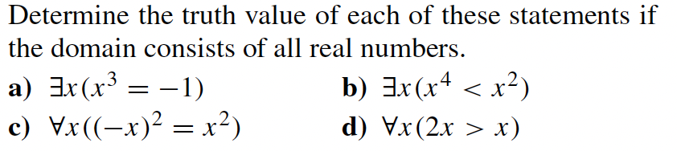
Quantifiers

Slide 51
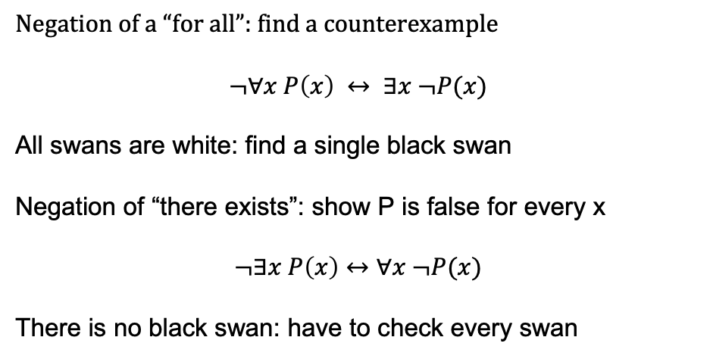
Negations of quantifiers
Negation of a “for all”: find a counterexample
$$¬∀x P\left(x\right) ↔ ∃x ¬P(x)$$
All swans are white: find a single black swan
Negation of “there exists”: show P is false for every x
$$¬∃x P\left(x\right)↔∀x ¬P(x)$$
There is no black swan: have to check every swan

